Slide 1
K.Balaji
Keyloger
3/21/2024 Annual Review

Slide 2
KEY LOGER
3/21/2024 Annual Review

Slide 3


AGENDA
What is keystroke logging? A keylogger is a program that runs in the background or hardware, recording all the keystrokes. Once keystrokes are logged, they are hidden in the machine for later retrieval, or shipped raw to the attacker  Attacker checks files carefully in the hopes of either finding passwords, or possibly other useful information
Key loggers, as a surveillance tool, are often used by employers to ensure employees use work computers for business purposes only  Such systems are also highly useful for law enforcement and espionage  Keystroke logging can be achieved by both hardware and software means.
3/21/2024 Annual Review

Slide 4

PROBLEM STATEMENT
Good: companies can monitor the productivity of an employee, also useful for software developing.
Bad: Espionage
Ugly: External hardware can be caught easily and software installation without user noticing is hard
3/21/2024 Annual Review

Slide 5

PROJECT OVERVIEW
Come in three types:
Online devices that are attached to the keyboard cable
Devices which can be installed inside standard keyboards
Replacement keyboards that contain the key logger already built-in
3/21/2024 Annual Review

Slide 6
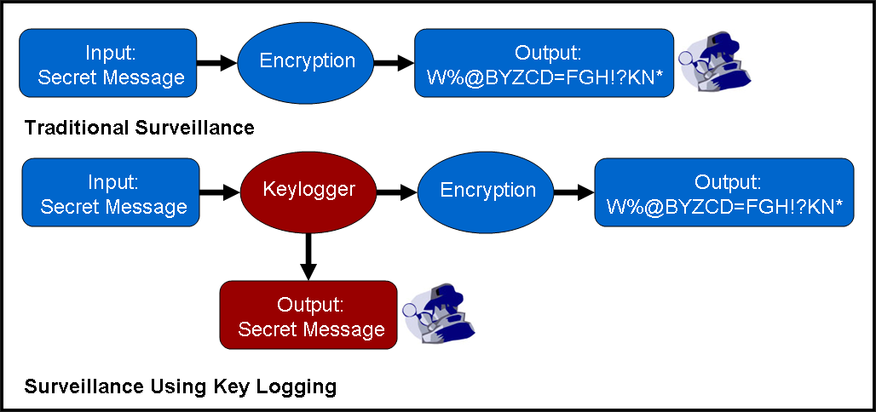

WHO ARE THE END USERS?
3/21/2024 Annual Review

Slide 7

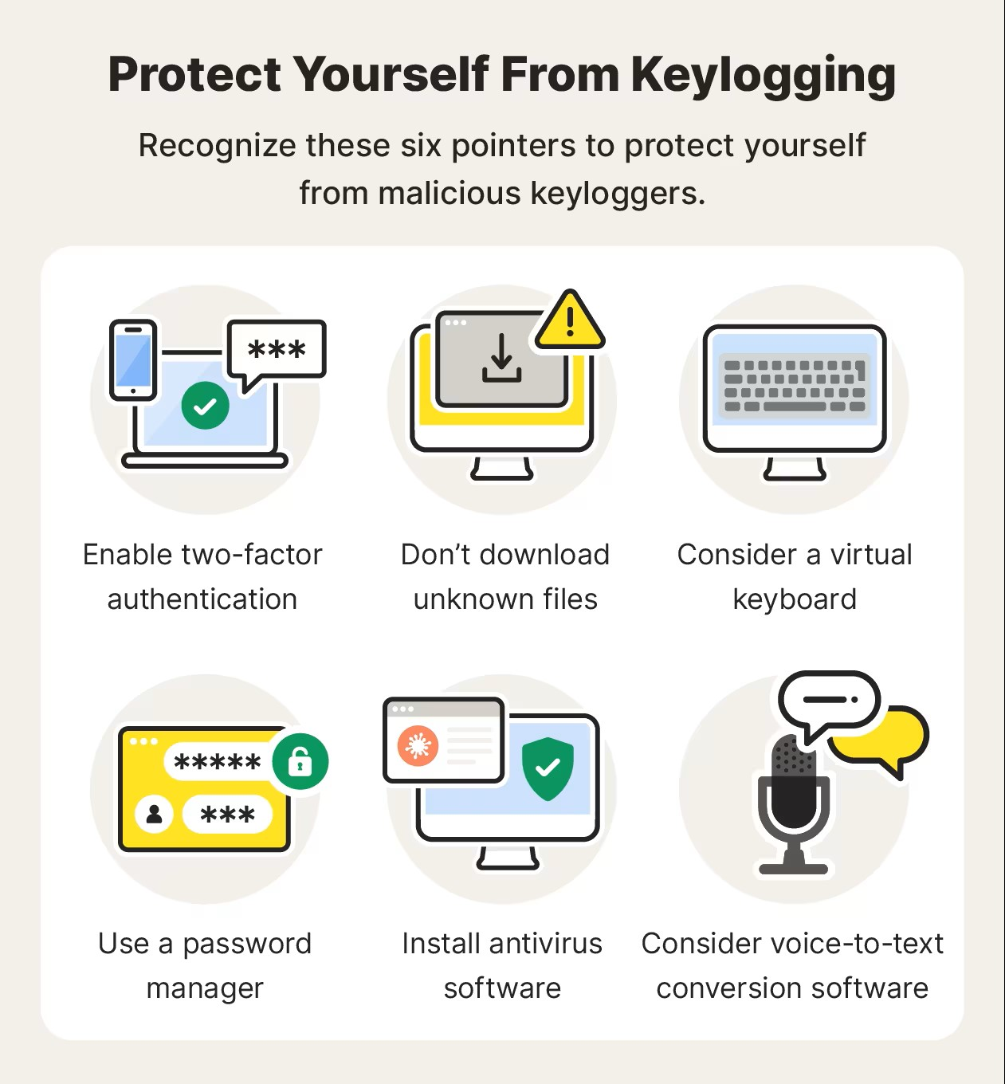
YOUR SOLUTION AND ITS VALUE PROPOSITION
3/21/2024 Annual Review

Slide 8
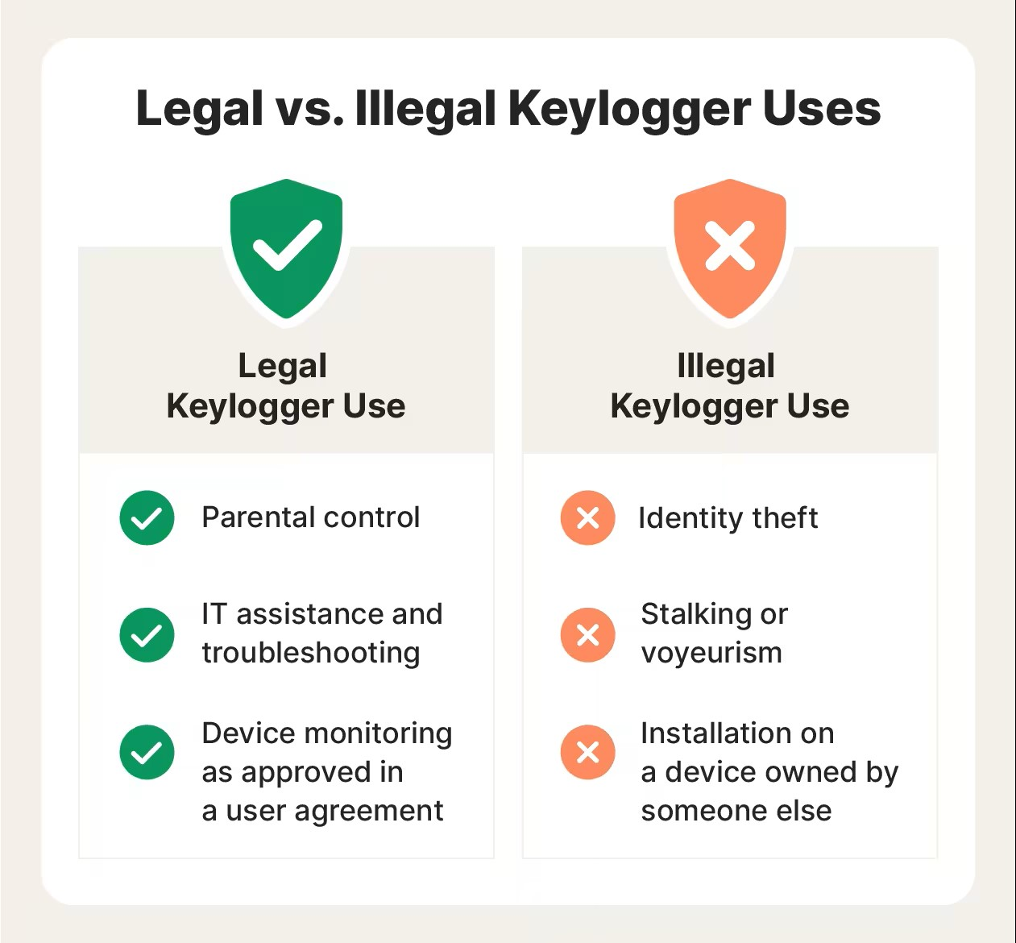

THE WOW IN YOUR SOLUTION
3/21/2024 Annual Review
8

Slide 9
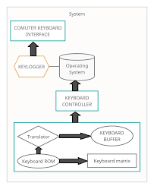
MODELLING
Teams cam add wireframes
3/21/2024 Annual Review
9

Slide 10
RESULTS
https://github.com/KDharmendraBalaji/KDB-APSSDC
3/21/2024 Annual Review
10

